Slide 1
Asynchronous Android
Async tasks, Loaders, Services and more
Iurii Okhmat

Slide 2
Agenda
Threads
Handlers / loopers
AsyncTasks
Loaders
Services

Slide 3
Multithreading
Asynchronous Android

Slide 4
Thread
Basic “building block”
Two ways to create threads:
Runnable
Subclassing
Inherits priority
setPriority()
Process.THREAD_PRIORITY_*

Slide 5
Controlling threads
Thread.sleep – causes current thread to suspend execution for specified period of time.
Not precise
Sleep can be terminated by interrupts
Thread.interrupt
boolean interrupted()
Clears “interrupted” flag (for current thread), external threads don’t clear flag.
Thread.join
Waits for a completion of another thread
As sleep can be interrupted
Demo

Slide 6
Threads synchronization
Efficient data sharing between threads
Source of errors:
Thread interference
Memory consistency errors
Synchronization to the rescue
Can cause thread starvation and deadlocks
Immutable objects
Useful in concurrent applications, since they can’t change state, they can’t be corrupted by threads.
Strategy for defining immutable objects
No “setters”
“Sealed” class (can’t override methods)
All fields are private and final. All reference fields are cloned.
Notes:
Traffic is a ‘hyper-local’ issue
Also regional problem
Traffic is a global issue

Slide 7
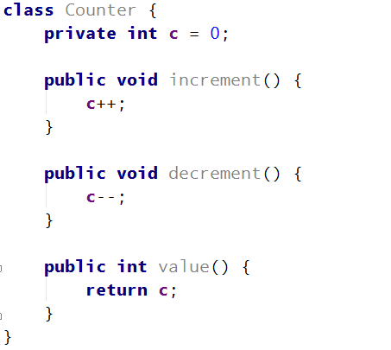
Problem: thread interference
Notes:
Traffic is a ‘hyper-local’ issue
Also regional problem
Traffic is a global issue

Slide 8
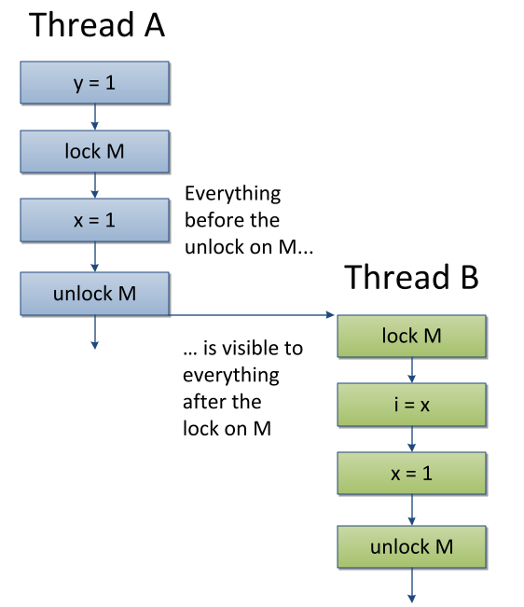
Problem: memory consistency
Complex (beyond the scope of this presentations)
Happens-before relationship – guarantee that memory writes by one statement are visible to another statement
http://docs.oracle.com/javase/8/docs/api/java/util/concurrent/package-summary.html#MemoryVisibility
Just know how to avoid it

Slide 9
Solution 1 - synchronized
Use synchronized (on methods and statements)
If one thread entered the synchronized method, all other threads will wait (intrinsic lock or monitor)
Synchronized statement establishes “happens-before” relationship
Can lead to thread liveness issues (deadlocks, starvations, etc)
Demo
Notes:
Traffic is a ‘hyper-local’ issue
Also regional problem
Traffic is a global issue

Slide 10
Solution 2 – Atomic access
Even a single action can lead to multiple VM instructions
Volatile – reduces the risk of memory consistency issues and establishes the happens-before relationship.
Notes:
Traffic is a ‘hyper-local’ issue
Also regional problem
Traffic is a global issue

Slide 11
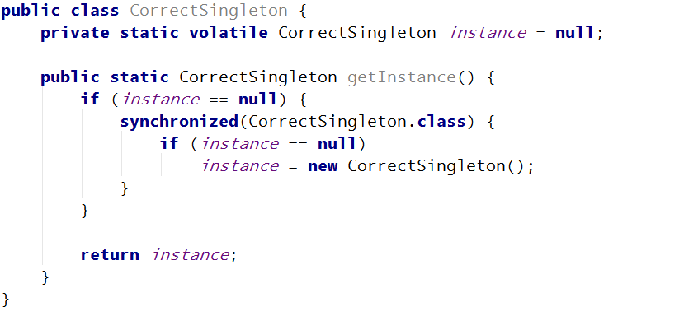
Correct way to implement singleton
Notes:
Traffic is a ‘hyper-local’ issue
Also regional problem
Traffic is a global issue

Slide 12
Thread liveness
Deadlock
Starvation
Livelock
Demo
Notes:
Traffic is a ‘hyper-local’ issue
Also regional problem
Traffic is a global issue

Slide 13
Deadlock demo
"LockThread 2" prio=5 tid=12 MONITOR | group="main" sCount=1 dsCount=0 obj=0x4132d108 self=0x360370 | sysTid=3104 nice=0 sched=0/0 cgrp=default handle=1931232 | schedstat=( 2110534641 2225708106 59775 ) utm=211 stm=0 core=0 at com.iuriio.apps.asyncandroid.app.DeadlockFragment.lock21(DeadlockFragment.java:~66) - waiting to lock <0x4132a418> (a java.lang.Object) held by tid=11 (LockThread 1) at com.iuriio.apps.asyncandroid.app.DeadlockFragment.access$100(DeadlockFragment.java:11) at com.iuriio.apps.asyncandroid.app.DeadlockFragment$2.run(DeadlockFragment.java:40) at java.lang.Thread.run(Thread.java:856)
"LockThread 1" prio=5 tid=11 MONITOR | group="main" sCount=1 dsCount=0 obj=0x4132cd48 self=0x35ff20 | sysTid=3103 nice=0 sched=0/0 cgrp=default handle=3644944 | schedstat=( 2095489695 2247283929 59777 ) utm=0 stm=209 core=0 at com.iuriio.apps.asyncandroid.app.DeadlockFragment.lock12(DeadlockFragment.java:~53) - waiting to lock <0x4132a428> (a java.lang.Object) held by tid=12 (LockThread 2) at com.iuriio.apps.asyncandroid.app.DeadlockFragment.access$000(DeadlockFragment.java:11) at com.iuriio.apps.asyncandroid.app.DeadlockFragment$1.run(DeadlockFragment.java:35) at java.lang.Thread.run(Thread.java:856)

Slide 14
High-level concurrency
Executors
ThreadPoolExecutor
ScheduledThreadPoolExecutor
ExecutorService
Synchronizers and thread pools
CountDownLatch – wait for completion
CyclicBarrier – Map reduce, fork-join processing
Demo
Exchanger
Demo
NOT Android-related
Java 7 contains ForkJoinPool, implementing work stealing algorithm.
Notes:
Lock interface
Almost same as “synchronized” but more versatile
Can help solving livelock issues
Executor
Use it instead of creating threads manually
Executors factory – use it to create callables, thread pools and various executors
ExecutorService – more flexible than Executor
Thread pool
Used by most of the executors
NOT Android-related
Java 7 contains ForkJoinPool, implementing work stealing algorithm.

Slide 15
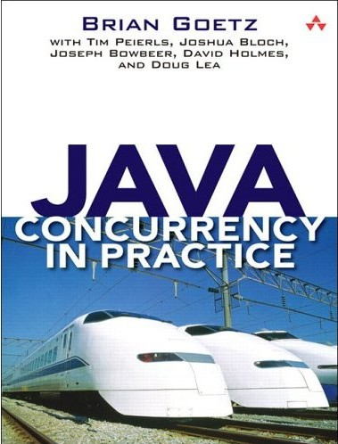
Suggested reading
Java Concurrency in Practice
Notes:
Traffic is a ‘hyper-local’ issue
Also regional problem
Traffic is a global issue

Slide 16
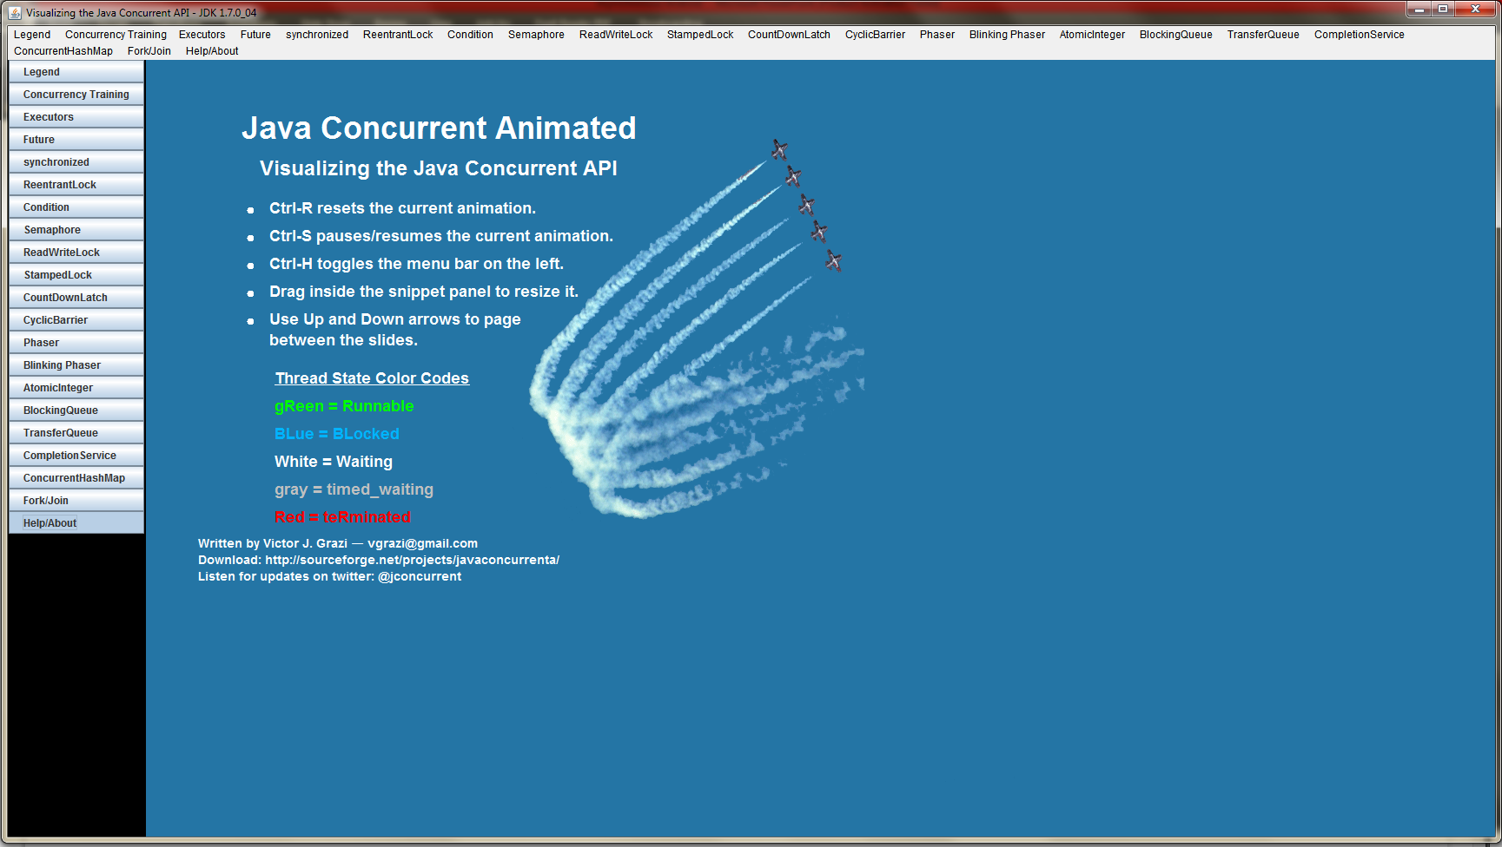
Cool app
http://sourceforge.net/projects/javaconcurrenta/
Notes:
Traffic is a ‘hyper-local’ issue
Also regional problem
Traffic is a global issue

Slide 17
Android-specific concurrency constructs
Async Android

Slide 18
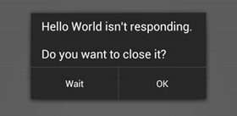
Don’t block UI thread
ANR
Tracking I/O and Network operations on UI thread with StrictMode
Demo
Notes:
Traffic is a ‘hyper-local’ issue
Also regional problem
Traffic is a global issue

Slide 19
Looper and Handler
Looper – turns thread into pipeline thread
Handler
Allows to send and process messages and runnable on the thread’s message queue (MQ)
Bound to the thread (and its MQ) it was created on.
Handler::post, postDelayed, postAtTime
Handler::handleMessage
Handler::obtainMessage
Handler::removeCallbacks
Non-static handler defined inside Activity has a reference to its outer class (Activity) can leak resources.
Notes:
Traffic is a ‘hyper-local’ issue
Also regional problem
Traffic is a global issue

Slide 20
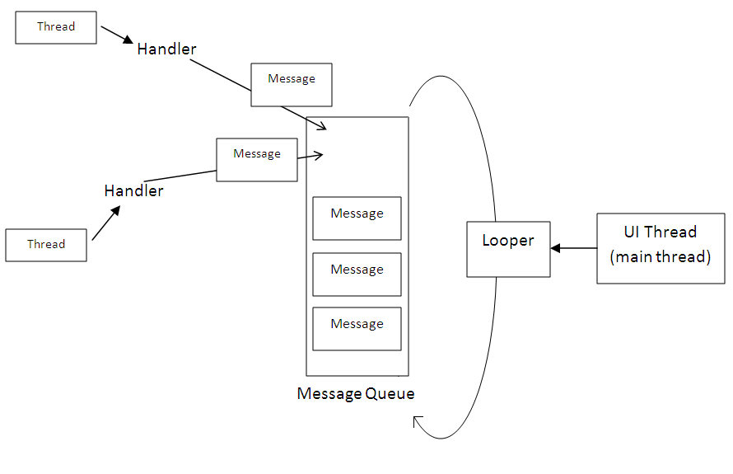
Looper and Handler
Notes:
Traffic is a ‘hyper-local’ issue
Also regional problem
Traffic is a global issue

Slide 21
Looper and Handler
HandlerThread – Creates its own looper, so that handlers can be bound to it.
Tip: Reusing handler
Demo 1 – Handler
Demo 2 – Spying on main message queue
Notes:
Traffic is a ‘hyper-local’ issue
Also regional problem
Traffic is a global issue

Slide 22
AsyncTask
Wrapper for Handler and Thread
Designed for short-lived background tasks (few seconds)
Convenient:
onPreExecute
doInBackground
onProgressUpdate
onPostExecute
Don’t forget to check for isCancelled
Since the arrival of Honeycomb (Android 3.0, API level 11), multiple AsyncTask instances are executed sequentially by default. If you want to change this behavior, you can have them executed on THREAD_POOL_EXECUTOR by invoking executeOnExecutor.
Demo
Notes:
Traffic is a ‘hyper-local’ issue
Also regional problem
Traffic is a global issue

Slide 23
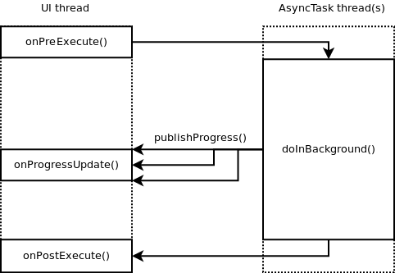
AsyncTask
Notes:
Traffic is a ‘hyper-local’ issue
Also regional problem
Traffic is a global issue

Slide 24
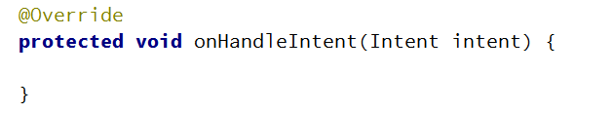
IntentService
Act as any other service in Android
Must be registered in Android Manifest
Pass information with Intent
Handle in onHandleIntent
Demo
Notes:
Traffic is a ‘hyper-local’ issue
Also regional problem
Traffic is a global issue

Slide 25
Loaders
LoaderManager
initLoader
restartLoader
LoaderManager.LoaderCallbacks
onCreateLoader
onLoadFinished
onLoaderReset
Loader
AsyncTaskLoader
CursorLoader
Demo
Notes:
Use CursorLoader to load information from ContentProvider.

Slide 26
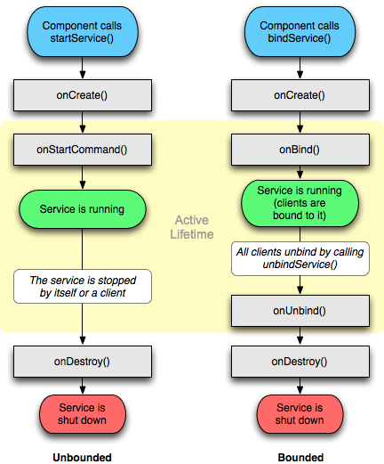
Services and RPC
Services
Local
Remote
Service Lifecycle
RPC
android.os.Binder
IADL
Messenger
Demo
Notes:
Traffic is a ‘hyper-local’ issue
Also regional problem
Traffic is a global issue

Slide 27
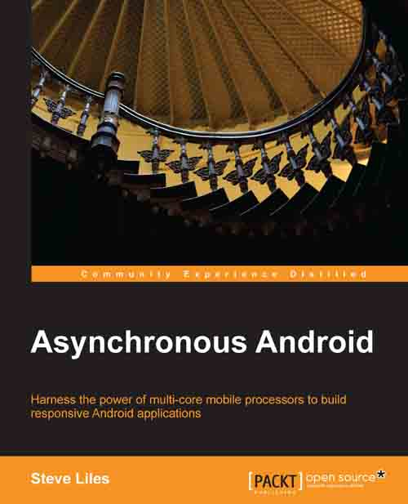
Suggested reading
Notes:
Traffic is a ‘hyper-local’ issue
Also regional problem
Traffic is a global issue

Slide 28
Questions?
… if you did enjoy the presentation, please let me know what would you like to hear about next time ;)

Slide 29
Thank you
Notes:
DI and IoC patterns and how they can be used in Android
Design patterns refresher – We use them every day without realizing. Refresh your knowledge on most common design patterns
Unit testing – concepts, tools and frameworks
P2P Communication – Bluetooth, WiFi Direct, NFC, etc.
Android internals – How it all works under the hood.

